Slide 1
Bitcoin
CSAT, RBI Grade “”B” IBPS, SBI
Evolution of Money
Functions of Money
Bitcoin system: features
Pros and Cons
Money laundering, Crime
Mt.Gox bankruptcy?
Laxmicoin, RBI stand
[GS3] Money laundering
Interview Stage
MCA/EC

Slide 2
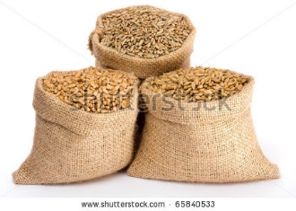

Barter system: Benefits
Simplest
Foreign Exchange regime…X
Concentration of wealth….X

Slide 3
Barter system: Problems
Double coincidence of wants
Division of labor…X
Perishable
Notes:
Jack of all trades

Slide 4
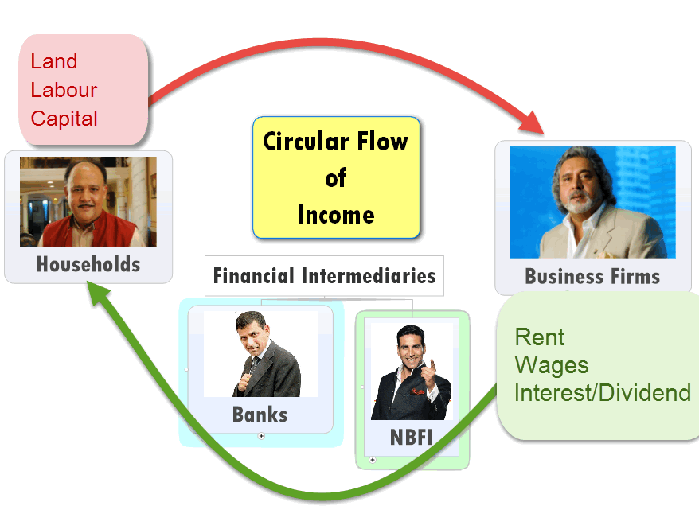
Saving => Capital…..NO

Slide 5
Barter system: Problems
Circular flow of income…X
Divisibility, Fungibility….X
Notes:
Jack of all trades

Slide 6
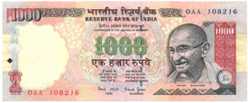
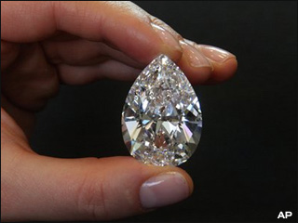
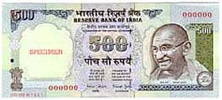

Fungibility: Mutual substitution

Slide 7
Functions of money?
Primary
Derivative

Slide 8

Primary functions
Medium of Exchange
Measure of Value
Why?
Readily acceptable.
Durability, Portable, Recognizable
Divisible, Fungible
Hard to Counterfeit

Slide 9

Functions of money?
Primary
Medium of Exchange
Measure of Value
Derivative

Slide 10
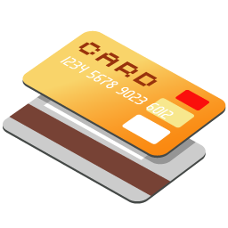
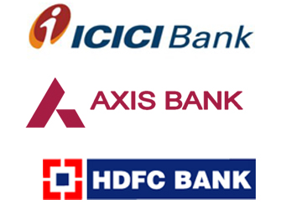
Derivative Functions
Store of Value (Savings => Investment)
Transfer of Value (Kashmir 2 Kanyakumari)
Deferred Payment (Time value of Money)

Slide 11
Functions of money?
Primary
Medium of Exchange
Measure of Value
Derivative
Store of Value
Transfer of Value
Deferred Payment

Slide 12
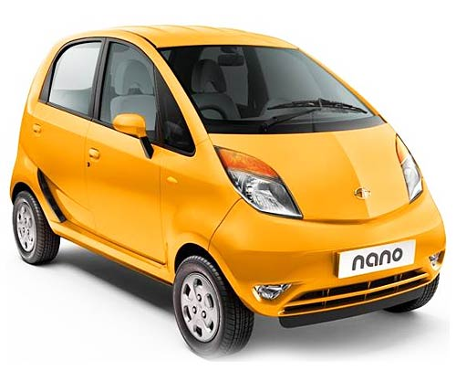
Other benefits:
Distribution of National income
Notes:
In a barter system, difficult to determine the how much each of them should earn from the total production. But money's primary function ="measure of value". Makes it possible to determine the share of individual worker in the total production and pay him accordingly. Anyone who provides any of the four factors of production (land, labour, capital, entrepreneurship) =he will earn money (as rent, wage, interest or profit) = less chances of exploitation (compared to the Barter system, feudal times, Zamindari bonded labours.) Thus, money helps in distribution of income among various factors of productio

Slide 13
Social empowerment
Factors of Production | Reward $$
Land (lease) | Rent
Labor | Wages
Capital | Interest Dividend
Entrepren- eurship | Profit
NOT the root of evil (Greed)

Slide 14
So far
Barter system: pros cons
Functions of money

Slide 15

Evolution of Money
Commodity Money
Metallic Money
Paper Money
Bank Money
Crypto Currency | Virtual Currency
(Bitcoin)

Slide 16

Commodity Money
Commodity to measure value
USA: tobacco, Corn, iron nails, Bear pelts
Aztec: cocoa beans
India, Pacific: Cowries
Fiji: Whale teeth
WW2 PoW: cigarettes

Slide 17

Commodity Money: pros & cons
Good
Intrinsic value
Notes:
Foreign trade=X
Inflation

Slide 18
Commodity Money: pros & cons
Bad
Face Value not same throughout region
Face value not same for outsiders (Cocoa)
Perishable- Hyper-Inflation
Bulky to Carry
Division of labour…..X
Notes:
Foreign trade=X
Inflation

Slide 19

Evolution of Money
Commodity Money
Metallic Money
Paper Money
Bank Money
Crypto Currency | Virtual Currency
(Bitcoin)

Slide 20
Metallic Money
Started as commodity money
Traders & Kings: uniformity, precision
Gold: high value
Silver: moderate
Copper/ Bronze: day to day purchases

Slide 21
Metallic Money: Good
Intrinsic value
Non-perishable
Divisible, Fungible, Melt-combine
Even foreign trade possible. (without exchange rate)
Production low, Prices stable
Hyperinflation…X

Slide 22
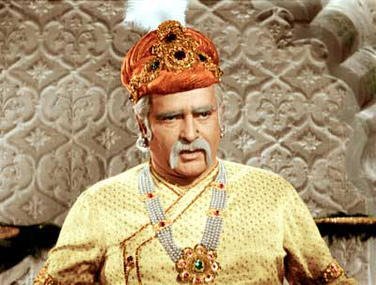
Metallic Money: problems?
Gold coin (Muhr)
Silver (Rupaiyaa)
Copper (Dam, Paisa)
Mansabdari Payment
Gold 50
Silver 25
Copper 25

Slide 23
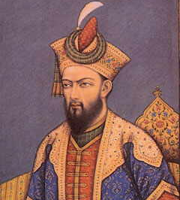
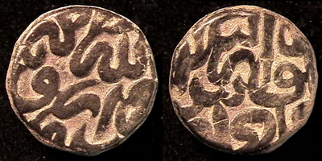
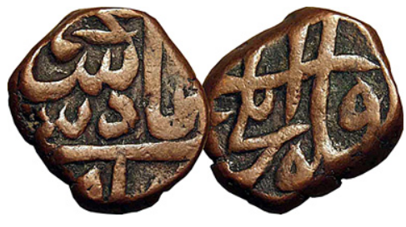
Copper “Dam”: Debasement
Barter system
Tax collection
East India
20 gm
13 gm

Slide 24
Metallic Money: Bad
Bulky to carry
Ship sinks, Wealth lost
Smuggling for intrinsic value => Debasement
bad money drives out good. (Grisham’s law)

Slide 25
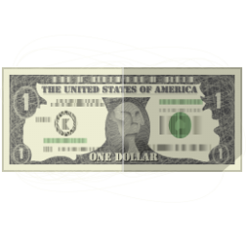
Evolution of Money
Commodity Money
Metallic Money
Paper Money (Fiat money)
Bank Money
Cryptocurrency (Bitcoin)

Slide 26
What is Fiat Money?
“Fiat” = legally binding command.
Fiat Money= by the command of the government.
US dollar, Indian Rupee, Euro, Yen, Yuan
Legally recognized to settle all debts & payments within territorial jurisdiction.
Notes:
Seeds, fertilizers=> cannot demand onions.

Slide 27
What is not Fiat Money?
Legal backing….X
Kirana walla plastic coins & coupons
Fake currency with film star photos
Shares, Bonds, Debentures, G-Sec, T-bill
DD, Cheques, Credit Card, ATM card
Bitcoin & other Digital currency
Notes:
other Digital currency, Crypto currency, virtual currency….X

Slide 28
Fiat Money types
Fiat Money
Gold Standard
Paper Standard

Slide 29

Gold Standard
Fiat
1 US $= 22 grains Gold
1 British Pound =113
1 Pound =113/22 =4.8 US$
During war…collapse
Post WW2: IMF-Gold standard…collapse

Slide 30
Paper Standard
Fiat
Central Bank free to print currency without gold backing.
Exchange Rates:
Fixed Exchange rate
Floating
“Managed”

Slide 31
India: paper standard
RBI
Government
Notes from Rs.2 to 1000. (earlier 10,000)
RBI Act 1934
Rs.1 note
All coins.
Rs 1 and 2 notes discontinued. (existing circulated)
Coinage Act 2011: Rs1 note. Fin.Secretary Rajiv Mehrishi, bilingual

Slide 32
Fiat Money: Problems?
Debasement: Over printing, Hyper inflation
Still Bulky to carry
Theft, fire, counterfeit
Change problem
Rounding off: (40p x 1 L=40k)
Notes:
For example, if a bank rounds off interest rate of Rs.15.40 to Rs.15, then every savings account holder is paid 40 paisaa less. If bank had one lakh account holders, it could save could save Rs.40,000 by just rounding off, thus considerable loss to customers as a whole.

Slide 33
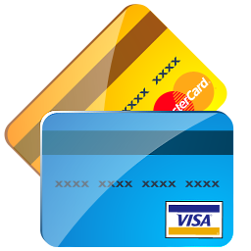
Evolution of Money
Commodity Money
Metallic Money
Paper Money (Fiat money)
Bank Money
Cryptocurrency (Bitcoin)

Slide 34
Bank Money?
Examples
Cheques, bank drafts
Credit card, debit cards,
Visacard, Master card, Rupay card
ATM card, NEFT, RTGS,

Slide 35
Bank Money?
Bank account
Current Account
Savings Account
Bank Money
Paper order
Electronic Orders
Payment
Spot
Deferred
FD

Slide 36
Benefits
Bank Money
Easy to transfer over long distance
Exact amount can be transferred (change problem…..X)
Hard to counterfeit
Can freeze if stolen [KYC]
Legally recognized for high value payment.

Slide 37

Evolution of Money
Commodity Money
Metallic Money
Paper Money (Fiat money)
Bank Money
Cryptocurrency (Bitcoin)

Slide 38
Why Virtual Currency?
Money
Subprime crisis=> US QE => Increased dollar supply
Dollar’s Purchasing power ▼
Banks charge fees on online transfer, credit card, ATM
Anarchist groups: Fiat currency….X
Notes:
a person who believes that government and laws are not necessary.

Slide 39

Bitcoin: Beginning
2008 Paper by Satoshi Nakomoto
Real identity unknown
2009 started
Notes:
He could be a man or a woman or a group of people- real identity unknown.

Slide 40







Slide 41
Total Reward
21 Mill.BTC
2031

Slide 42
Data
Block
Total
21 Million
50 BTC
25 BTC
12.5
6.25
Reward declines over time
With each 2.1 lakh Datablocks

Slide 43
Total Reward
21 Mill.BTC;
1BTC
=10(^8) Satoshi

Slide 44
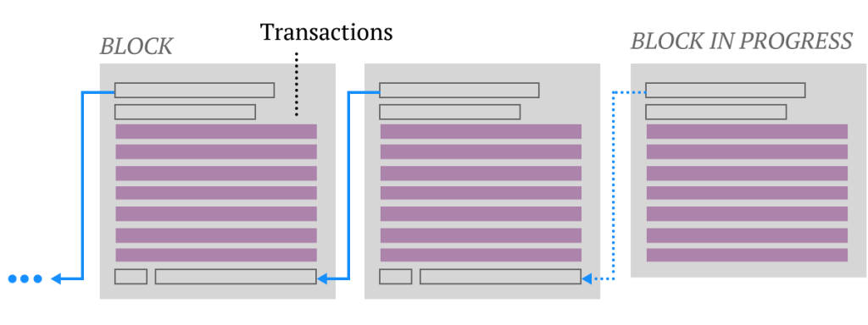

Mining software
Solving speed Hashrate/sec
Laptop: 30 kh/s =>
.003 BTC (24 hrs.)
MINUS lightbill = 3$
Notes:
Decreases over time

Slide 45
Reward distribution
As per Hashrate
1 BTC= 10(^8) Satoshi
1 Satoshi= 0.00000001 BTC
Mining Pool
Notes:
25 btc per datablock.

Slide 46
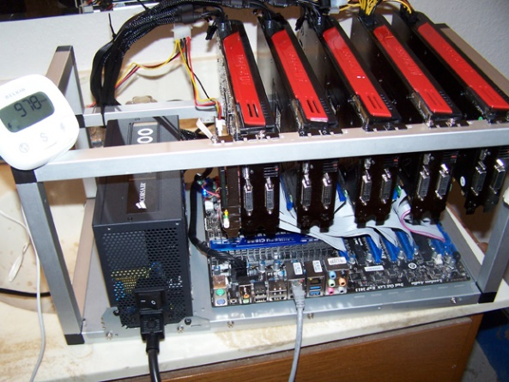
Mining rigs
Bitcoin
GPU hashrate
Higher than
CPU

Slide 47
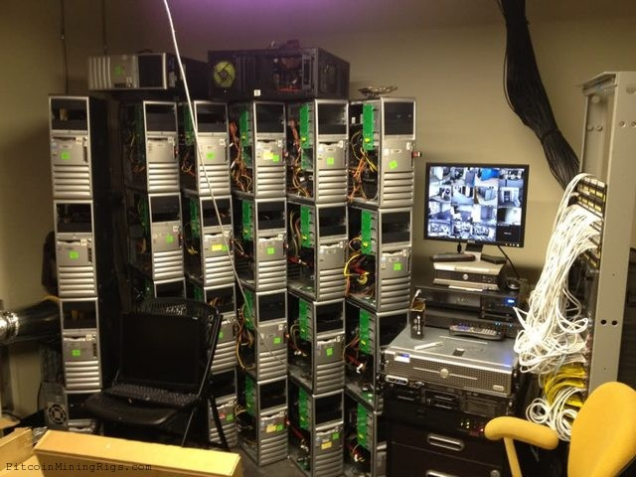
Mining rigs
Bitcoin
5 GPU in 1 PC
Over 4 dozen PCs

Slide 48
Reward distribution
As per Hashrate
1 BTC= 10(^8) Satoshi
1 Satoshi= 0.00000001 BTC
Mining Pool
Notes:
25 btc per datablock.
Quantam computers

Slide 49
Evolution of money
Bitcoin concept
Bitcoin mining

Slide 50



Bitcoin Transfer? Digital Wallet / E-Wallet software
Public address (email address)
Private key (password)
No names, No IP, No phone numbers

Slide 51
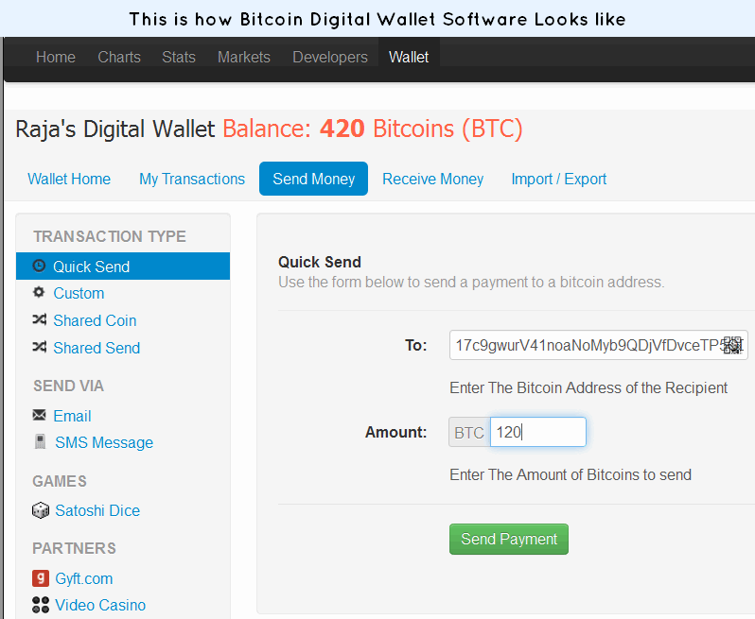

Slide 52
Double spending?
Email client (outlook)
Bitcoin (digital wallet)
One mail forwarded to many
Double spending?...No

Slide 53

Block Chain
Public ledger
Validity of Each transaction
10 minutes
Notes:
Validity of each transaction

Slide 54
Bitcoin vs. NEFT & RTGS
Positive
Negative

Slide 55
Bitcoin vs SBI Netbanking
RTGS: Real Time Gross Settlement | NEFT: National Electronic Fund Transfer | Bitcoin
Retail: 2-5 Corporate: >5 | 50k at a time | No ceiling
Processing fees 25-55 RS. (SERVICE TAX) | 2.50-25 | None
Instant | “1 hour” cycles. | upto 10 minutes

Slide 56
Bitcoin vs Netbanking
RTGS | NEFT | Bitcoin
Weekdays: 8 AM– 6.30PM Saturday: 8 to 1.30 Sunday: Holiday |  | 24/7
Central monitoring RBI |  | None
Can recover password |  | gone

Slide 57
Bitcoin vs Netbanking
RTGS | NEFT | Bitcoin
Bank account number Branch IFSC code |  | Only public address of wallet
Both need bank account, fulfill KYC norms |  | even robot / AI can.
Notes:
No commission hence banks Hate

Slide 58
Money laundering, Terrorism, Gambling illegal activities
In Bitcoin system?

Slide 59
Mining
Selling goods & services
Speculators:
Oct.’13: $200
Dec’ 13: $1200
Feb’ 15: $230

Slide 60

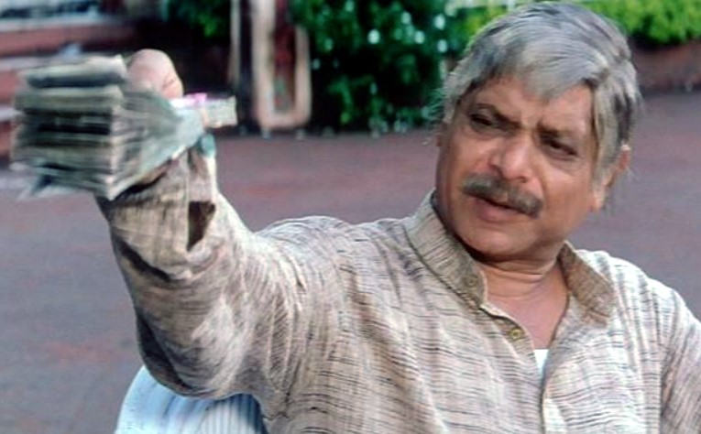
Block Chain
Only Public & private key
No names, phone numbers, addresses
No Central authority to record IP.
Notes:
Royal Challengers Bangalore

Slide 61
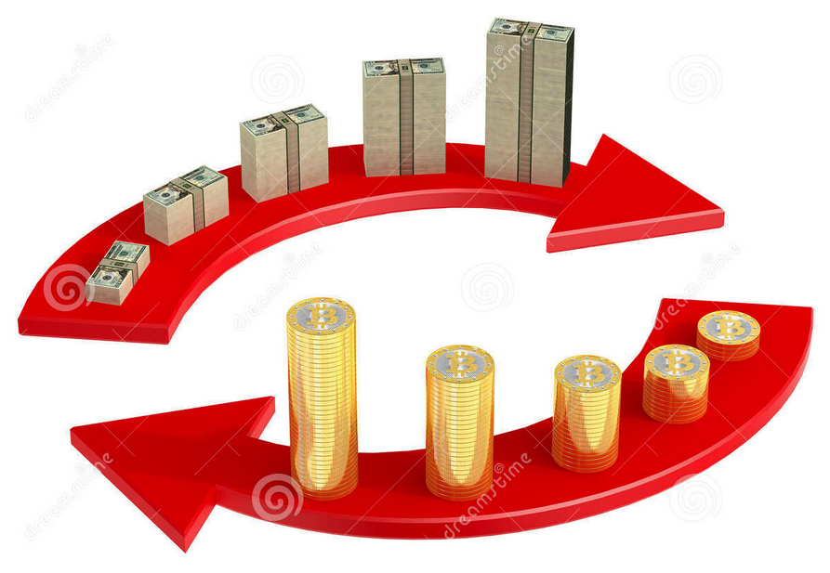

Notes:
Royal Challengers Bangalore

Slide 62

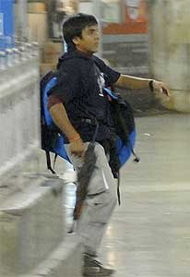
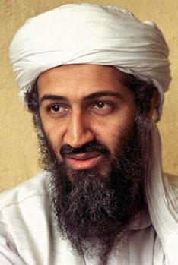
Convert to $$
TAX HAVEN
Notes:
Royal Challengers Bangalore

Slide 63
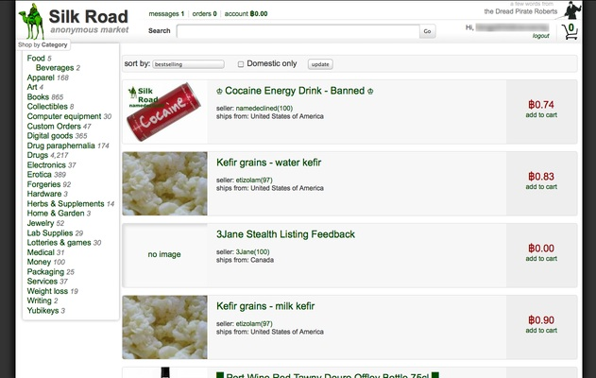
Online shopping using Bitcoins

Slide 64
Buy goods services
Bitcoins
Silkroad: cocaine
2013: FBI shut down
Legit Online shopping sites
Some Pizza parlors, fashion stores
IT professionals (not FIAT)
Notes:
Hippie type
rent

Slide 65
Why: Bitcoin exchange?
How to get Bitcoin?
Mining
Selling goods/services
Exchange Currency
Speculators:
Dec.’13: $1200
Feb.’15: $230

Slide 66
2013: Bitcoin Exchange (Mt.Gox)
People’s Bank of China
RBI

Slide 67
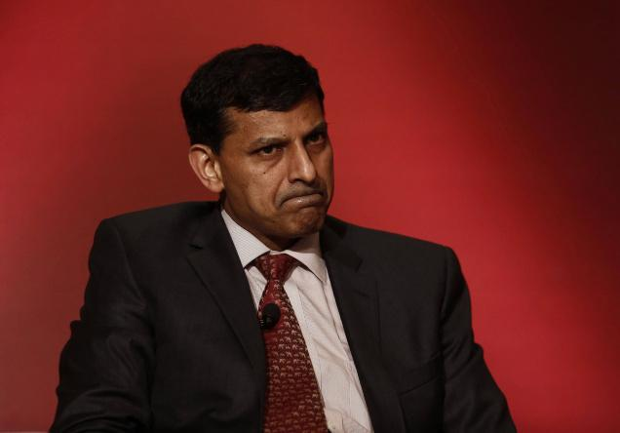
RBI stand Dec 2013
Bitcoin
“Decentralised Digital Currency” or “Virtual Currency”
3 ways to aquire
Mining
Trading goods-services
Exchange with Fiat currency

Slide 68
RBI stand Dec 2013
Bitcoin
No central bank has authorized Bitcoins
Not Traded through BSE, NSE, Commodity exchange (SEBI, FMC)
No Forex dealers under FEMA: Converting $$=Rs=Bitcoin illegals

Slide 69
RBI stand Dec 2013
Bitcoin
Bitcoin Exchange website = legal status unclear
Danger: hacking, phishing, malware, password lost
Consumer courts cannot help

Slide 70
RBI stand Dec 2013
Bitcoin
Mere digital code, no intrinsic value, not backed by Gold, silver or crude oil.
Speculation, volatility (1200=>200)

Slide 71
RBI stand Dec 2013
Bitcoin
Media reports on illegal drug, money laundering, terror-financing.
unintentionally breach anti-money laundering / Anti-terror laws
Same with litecoins, bbqcoins, dogecoins etc.

Slide 72

A’bad Raid (December 2013)
Buysellbitco.in
First Bitcoin exchange in India
Mahim Gupta, Bopal
ED, FEMA (Authorized dealers)
Prevention of Money laundering Act 2002 (3-7 years | 5 lakh)
Notes:
1 BTC= 1k $ = 60k.

Slide 73
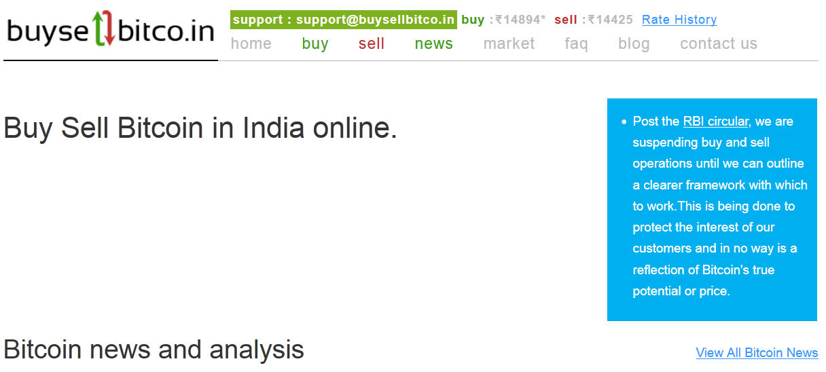
Screenshot (2015, Feb)
Buy: ~14,800
Sell: ~14,400

Slide 74

Laxmicoin.com
Mitts Daki (US) and Raj Dangi (Banglore)
=> 30% NGO, poor
No RBI reply (since 2013)
RBI stand: “Examining the issues in Digital currency”

Slide 75
Mt.Gox scam Mt. Gox Bankruptcy?

Slide 76
Software bug
Bitcoin =>resend back
8,50,000 Bitcoin stolen [offline?]
$ 500 million lost
Filed Bankruptcy in Japan Court
April 2014: liquidation
Notes:
7% of world BTC
Something fishy- offline computers

Slide 77
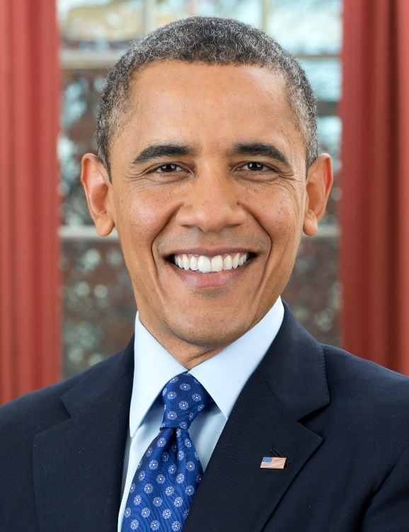
IRS USA (March 2014)
Bitcoin Taxable Property / commodity
Capital Gains tax (23%)
Withholding norms.
Notes:
What should India do?

Slide 78
Interview Questions
How does Bitcoin system work?
Benefits and limitations?
Should it be given legal recognition in India?
Measures to curb money laundering, terror-financing, drug rackets?

